Slide 1
Comparison of Object Detection Methods: Viola-Jones vs. Alternative Algorithms
Hog and YOLO

Slide 2
How to Train a Object Detection Engine with HOG in OpenCV
HOG is a method for generating feature vectors from an image area. Most likely, the object in this area determines most of the feature vector. Using HOG to detect objects is not difficult: you just draw a few bounding boxes randomly on the image. Then you can find the feature vector of the bounding box using HOG and compare the vector with what you expected for the target object.

Slide 3
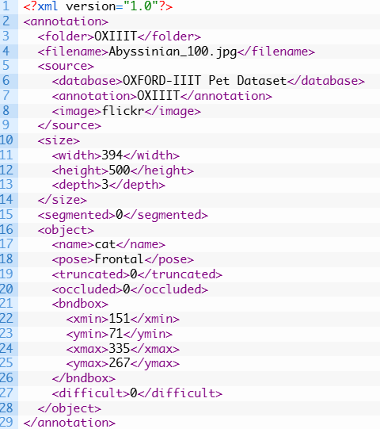
Let's look at the task of detecting cats.a dataset with a cat image from the Oxford-III Pet Dataset. The images are annotated in the Pascal VOC format. In short, each image has a corresponding XML file that looks like this:

Slide 4
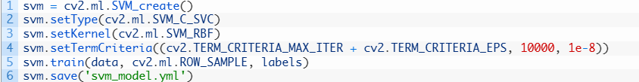
A training classifier using HOG features
OpenCV comes with the SVM module in cv2.ml and it works similarly to scikit-learn. Basically, you just need to do the following to learn:
First, you create an SVM object using cvv2.ml.SVM_create(). Then you customize SVN, as there are many variations. In the example above, you used SVN_C_SVCd as the type because it is a C-Support Vector Classifier (SVM for classification that allows imperfect separation).

Slide 5
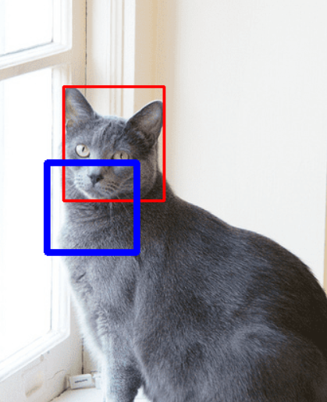
OpenCV will display the annotated images one by one from the dataset. The bounding rectangle of the dataset is shown in red, and the bounding rectangle reported by the SVM is shown in blue. Please note that this is a cat detector, so ideally nothing should be detected if it is an image of a dog. However, an SVM with a HOG function is not very good at this.

Slide 6
How Object Tracking works on YOLO
YOLO is a modern real—time project management system.
YOLO (You Only Look Once) carries the philosophy of looking at a picture once, and during this one viewing (that is, one image run through one neural network) to make all the necessary definitions of objects.
How does this happen?

Slide 7
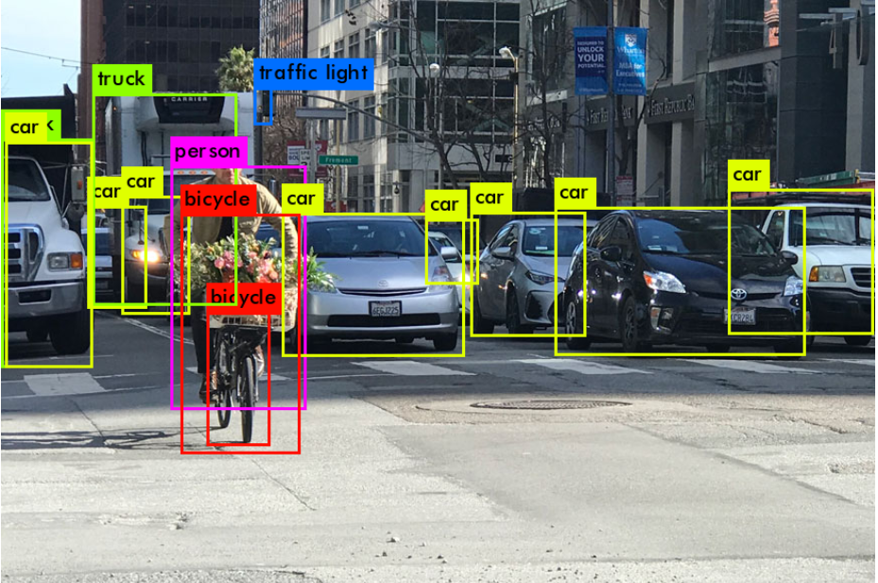
when we leave YOLO's work, we usually want this:

Slide 8
What YOLO does when it learns from data (in simple words):
Step 1: Usually, the images are reshaped to a size of
416x416 before starting training the neural network,
so that they can be submitted in batches (to speed
up learning).Step
2: Divide the picture (mentally so far) into axa-sized
cells. In Yolo, 3-4 is usually divided into 13x13 cells
(we'll talk about different scales later to make it clearer).

Slide 9
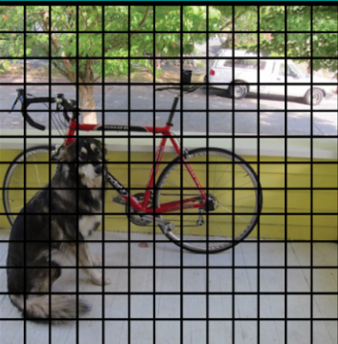
Now let's focus on these cells, into which we have divided the picture/frame. Such cells, called grid cells, are the basis of the idea of YOLO. Each cell is an "anchor" to which the bounding boxes are attached.

Slide 10
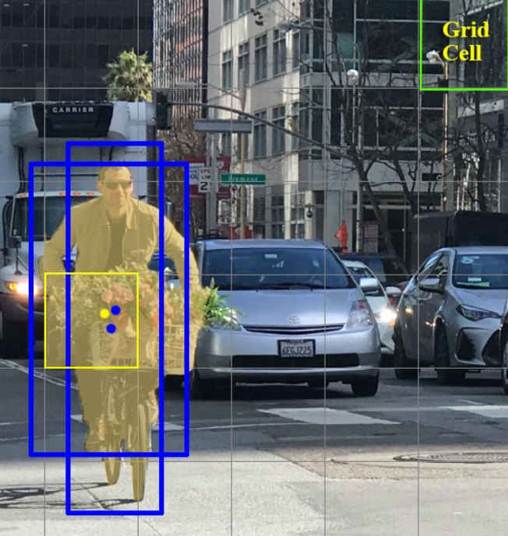
How are these rectangles (bounding boxes) drawn around the cell? How is their size and position determined? This is where the anchor boxes technique (translated as anchor boxes, or "anchor rectangles") comes into play. They are set at the very beginning either by the user himself, or their sizes are determined based on the sizes of the bounding boxes that are in the dataset on which YOLO will train (K-means clustering and IoU are used to determine the most suitable sizes).

Slide 11
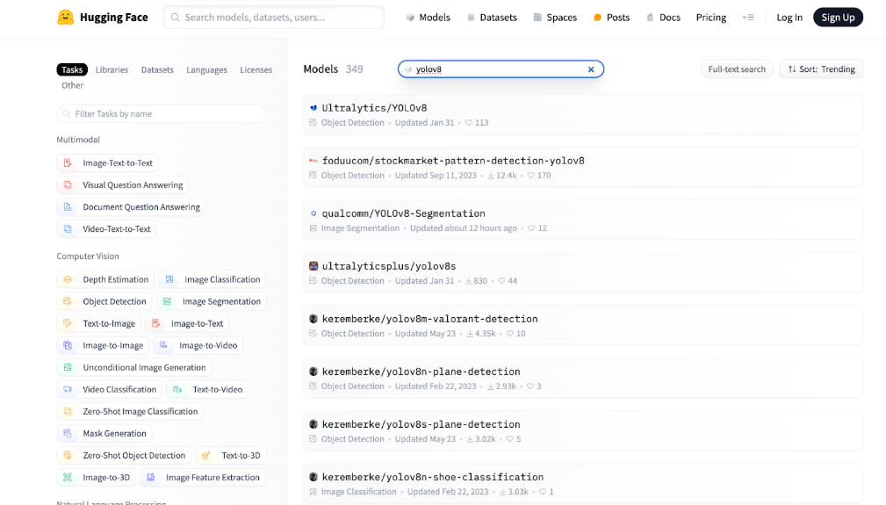
How can I apply YOLO models to my devices?
deploying models becomes easy. This is all thanks to the modules found in the Viam registry and the open source YOLO models in the repositories, such as Hugging Face, or those that you created yourself.

Slide 12
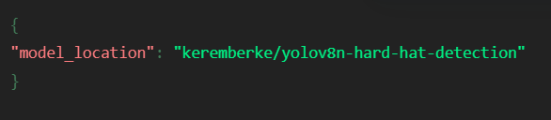
After configuring your device in Viam, you will only need to:
Add the YOLOv5 or YOLOv8 Vision Service module to your configuration.
Go to Hugging Face and find a model that suits your taste.Enter the model's location in JSON. This will tell the YOLO module where to point the pointer.
For example, the following code tells the Vision Service to point a pointer to the helmet detection model in the HuggingFace repository.

Slide 13
Feature | Viola-Jones | HOG + SVM | YOLO (You Only Look Once)
Detection Type | Face Detection (primarily) | General Object Detection | Real-Time Object Detection
Approach | Haar-like features + AdaBoost | HOG (Histogram of Oriented Gradients) + SVM (Support Vector Machine) | Deep Learning (CNN-based)
Speed | Fast, but less efficient on complex images | Slower than Viola-Jones but more accurate | Very fast, real-time detection
Accuracy | Moderate, high false positives | Higher than Viola-Jones, better generalization | High accuracy, robust to variations
Training Data | Requires many positive and negative samples | Requires labeled training data for SVM | Requires a large dataset, pre-trained models available
.

